Slide 1


INSTITUTE - UIE
DEPARTMENT- ACADEMIC UNIT-2
Bachelor of Engineering (Computer Science & Engineering)
Subject Name: Introduction to Problem Solving
Code:22CSH-101
CHAPTER NAME -FUNCTIONS

Slide 2

Course objectives
OBJECTIVES
The course aims to provide exposure to problem solving with programming
The course aims to raise the programming skills of students via logic building capability
With the knowledge of C language students would be able to model real world problems

Slide 3



Course Outcomes
CO Number | Course Outcome
CO1 | Remember the concepts related to fundamentals of C language, draw flowcharts and write algorithm/pseudocode.
CO2 | Understand the way of execution and debug programs in C language.
CO3 | Apply various constructs, loops, functions to solve mathematical and scientific problem.
CO4 | Analyze the dynamic behavior of memory by the use of pointers.
CO5 | Design and develop modular programs for real world problems using control structure and selection structure.

Slide 4
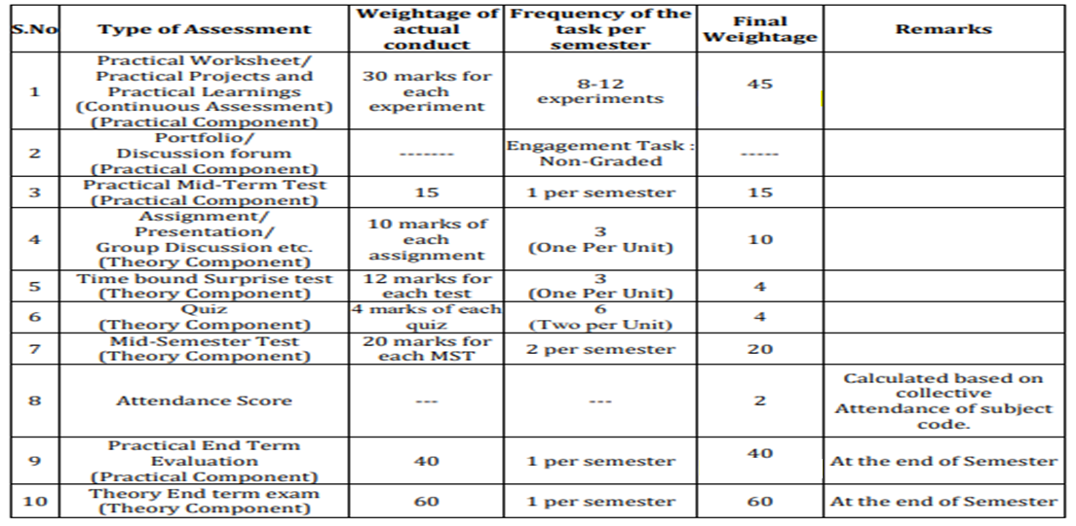
Scheme of Evaluation

Slide 5
Function & its Types
CONTENT
Predefined library functions
Built-in-string functions
Examples

Slide 6
A function is a block of code that performs a specific task.
Suppose, you need to create a program to create a circle and color it. You can create two functions to solve this problem:
create a circle function
create a color function
Dividing a complex problem into smaller chunks makes our program easy to understand and reuse.
Concept of Function

Slide 7
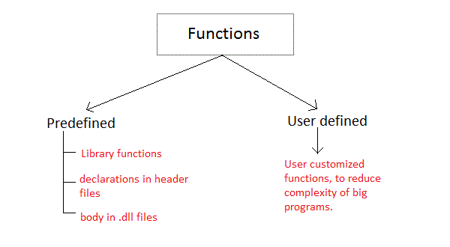
There are two types of function in C programming:
Types of Function
In this lecture , we discuss only Predefined functions. User defined functions will be discussed in next lecture.

Slide 8
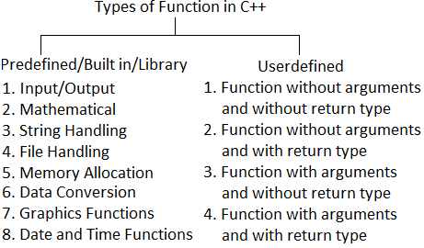
Types of Function
In this lecture , we discuss only Predefined functions. User defined functions will be discussed in next lecture.

Slide 9
They are inbuilt functions in C programming. The prototype and data definitions of these functions are present in their respective header files. To use these functions we need to include the header file in our program.
Example: If you want to use the printf function, the file header <stdio.h> should be included.
#include <stdio.h>
int main()
{
printf("Hello");
}
If you try to use printf without including the stdio.h header file, you will get an error.
Predefined
Library
Functions

Slide 10
1. They are simple because they work
One of the most important reasons you should use library functions is simply because they work. These functions have gone through multiple rigorous testing and are easy to use.
2. The functions are optimized for performance
Since, the functions are "standard library" functions, a dedicated group of developers constantly make them better. In the process, they are able to create the most efficient code optimized for maximum performance.
3. It saves considerable development time
Since the general functions like printing to a screen, calculating the square root, and many more are already written. You shouldn't worry about creating them once again.
4. The functions are portable
With ever-changing real-world needs, your application is expected to work every time, everywhere. And, these library functions help you in that they do the same thing on every computer.
Advantages of using C library Function

Slide 11
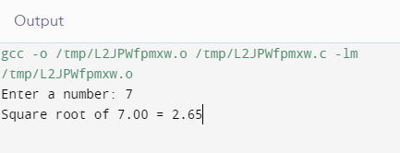
Example: Write a program in C to find square root of a number.
You can compute the square root of a number, you can use the sqrt() library function. The function is defined in the <math.h> header file
#include <stdio.h>
#include <math.h>
int main()
{
float num, root;
printf("Enter a number: ");
scanf("%f", &num);
root = sqrt(num);
printf("Square root of %.2f = %.2f", num, root);
return 0;
}
Example of Library Function

Slide 12
<assert.h> Program assertion functions
<ctype.h> Character type functions
<locale.h> Localization functions
<math.h> Mathematics functions
<setjmp.h> Jump functions
<signal.h> Signal handling functions
<stdio.h> Standard Input/output functions
<stdlib.h> Standard Utility functions
<String.h> String handling functions
<time.h> Date time functions
C
Headers Files

Slide 13
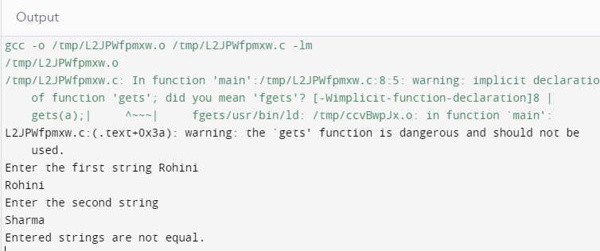
C programming language provides a set of pre-defined functions called string handling functions to work with string values. The header file called string.h is used, whenever we want to use any string handling function
Example: Program to compare two strings by using strcmp() function.
#include<stdio.h>
#include<string.h>
int main()
{
char a[100], b[100];
printf("Enter the first string\n");
gets(a);
printf("Enter the second string\n");
gets(b);
if( strcmp(a,b) == 0 )
printf("Entered strings are equal.\n");
else
printf("Entered strings are not equal.\n");
return 0;
}
Built-in
String Functions

Slide 14
Function | Syntax (or) Example | Description
strcpy() | strcpy(string1, string2) | Copies string2 value into string1
strncpy() | strncpy(string1, string2, 5) | Copies first 5 characters string2 into string1
strlen() | strlen(string1) | returns total number of characters in string1
strcat() | strcat(string1,string2) | Appends string2 to string1
strncat() | strncpy(string1, string2, 4) | Appends first 4 characters of string2 to string1
strcmp() | strcmp(string1, string2) | Returns 0 if string1 and string2 are the same; less than 0 if string1<string2; greater than 0 if string1>string2
strncmp() | strncmp(string1,string2,4) | Compares first 4 characters of both string1 and string2
strcmpi() | strcmpi(string1,string2) | Compares two strings, string1 and string2 by ignoring case (upper or lower)
strlwr() | strlwr(string1) | Converts all the characters of string1 to lower case.
String Handling Functions

Slide 15
Function | Syntax (or) Example | Description
strrev() | strrev(string1) | It reverses the value of string1
strchr() | strchr(string1, 'b') | Returns a pointer to the first occurrence of character 'b' in string1
strrchr() | 'strrchr(string1, 'b') | Returns a pointer to the last occurrence of character 'b' in string1
strstr() | strstr(string1, string2) | Returns a pointer to the first occurrence of string2 in string1
strset() | strset(string1, 'B') | Sets all the characters of string1 to given character 'B'.
strupr() | strupr(string1) | Converts all the characters of string1 to upper case.
strdup() | string1 = strdup(string2) | Duplicated value of string2 is assigned to string1
strnset() | strnset(string1, 'B', 5) | Sets first 5 characters of string1 to given character 'B'.
String Handling Functions

Slide 16
SUMMARY…..
We covered function and its types
Library function
Built-in String Functions

Slide 17
FREQUENTLY ASKED QUESTIONS
PROGRAMS
1. Write a program to reverse a string “Hello” using strrev( ) function.
2.Write a program to concatenate using strcat() function.
3. Write a program to calculate Power of a number Using pow() Function
4. Program to calculate the time taken to add two numbers program.
5. Program to calculate the length of a string entered by a user

Slide 18
1. Which standard library function will you use to find the last occurance of a character in a string in C?
A. strnchar()
B. strchar()
C. strrchar()
D. strrchr()
2. Input/output function prototypes and macros are defined in which header file?
A. conio.h
B. stdlib.h
C. stdio.h
D. dos.h
3.What is stderr ?
A. standard error
B. standard error types
C. standard error streams
D. standard error definitions
UTILISE YOUR KNOWLEDGE TO ANSWER
Let us see how much you have learned from the lecture and how effectively you can apply your knowledge…!!

Slide 19
4. What will be the output of the following C code?
void main()
div_t res;
res = div(34, 4);
printf("quotient part = %d\n", res.quot);
printf("remainder part = %d\n", res.rem);
}
a) quotient part=0
remainder part=4
b) quotient part=8
remainder part=2
c) quotient part=4
remainder part=0
d) quotient part=2
remainder part=8
UTILISE YOUR KNOWLEDGE TO ANSWER
Let us see how much you have learned from the lecture and how effectively you can apply your knowledge…!!

Slide 20
Video lectures:
https://nptel.ac.in/courses/106/101/106101208/
https://spokentutorial.org/watch/C%2Band%2BCpp/String%2BLibrary%2BFunctions/Manipuri/
Weblinks:
https://www.tutorialspoint.com/cprogramming/c_functions.htm
https://beginnersbook.com/2014/01/c-strings-string-functions/
https://beginnersbook.com/2014/01/c-functions-examples/
REFERENCES
Vedio Lectures
Weblinks

Slide 21
THANK YOU….

